Slide 1
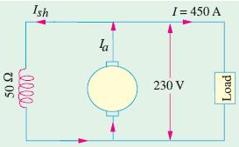
Example-1
A shunt generator delivers 450 A at 230 V and the resistance of the shunt field and armature are 50 Ω and 0.03 Ω respectively. Calculate the generated e.m.f.
Solution:
Current through shunt field winding is
Ish = 230/50 = 4.6 A
Load current I = 450 A
∴ Armature current Ia= I + Ish
= 450 + 4.6 = 454.6 A
Now Eg = terminal voltage + armature drop = V + IaRa
∴ e.m.f. generated in the armature
Eg = 230 + 13.6 = 243.6 V

Slide 2
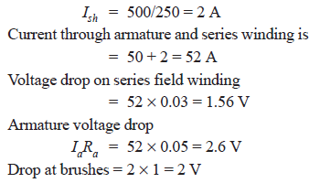
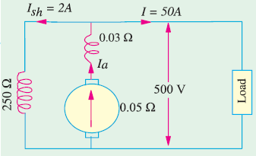

Example - 2
A long-shunt compound generator delivers a load current of 50 A at 500 V and has armature, series field and shunt field resistances of 0.05 Ω, 0.03 Ω and 250 Ω respectively. Calculate the generated voltage and the armature current. Allow 1 V per brush for contact drop.

Slide 3
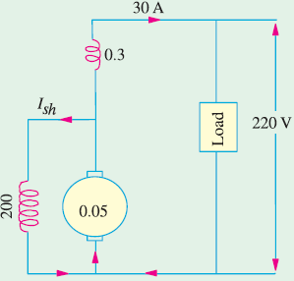
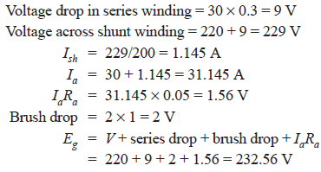
Example - 3
A short-shunt compound generator delivers a load current of 30 A at 220 V, and has armature, series-field and shunt-field resistances of
0.05 Ω, 0.30 Ω and 200 Ω respectively. Calculate the induced e.m.f. and the armature current. Allow 1.0 V per brush for contact drop.

Slide 4
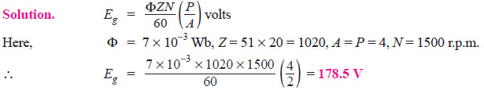
Example - 4
A four-pole generator, having wave-wound armature winding has 51 slots, each slot containing 20 conductors. What will be the voltage generated in the machine when driven at 1500 rpm assuming the flux per pole to be 7.0 mWb ?

Slide 5
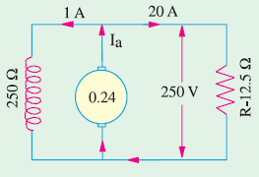
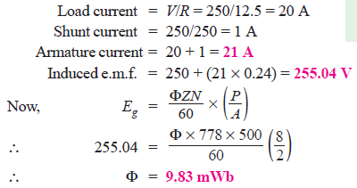
Example - 4
An 8-pole d.c. shunt generator with 778 wave-connected armature conductors and running at 500 r.p.m. supplies a load of 12.5 Ω resistance at terminal voltage of 250 V. The armature resistance is 0.24 Ω and the field resistance is 250 Ω. Find the armature current, the induced e.m.f. and the flux per pole.

Slide 6

Example - 5
A 4-pole lap-connected armature of a d.c. shunt generator is required to supply the loads connected in parallel :
(1) 5 kW Geyser at 250 V, and
(2) 2.5 kW Lighting load also at 250 V.
The Generator has an armature resistance of 0.2 ohm and a field resistance of 250 ohms. The armature has 120 conductors in the slots and runs at 1000 rpm. Allowing 1 V per brush for contact drops and neglecting friction, find (1) Flux per pole, (2) Armature-current per parallel path.

Slide 7
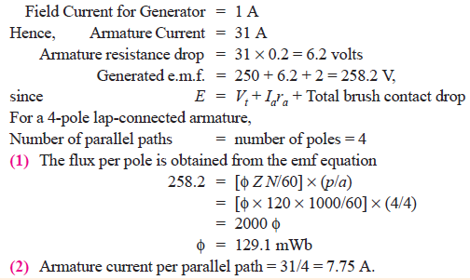
Example - 5

Slide 8
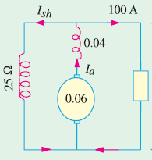
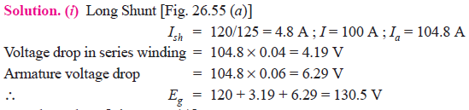
Example - 6
In a 120 V compound generator, the resistances of the armature, shunt and series windings are 0.06 Ω, 25 Ω and 0.04 Ω respectively. The load current is 100 A at 120 V. Find the induced e.m.f. and the armature current when the machine is connected as (i) long-shunt and as (ii) short-shunt. How will the ampere-turns of the series field be changed in (i) if a diverter of 0.1 ohm be connected in parallel with the series winding ? Neglect brush contact drop and ignore armature reaction.

Slide 9
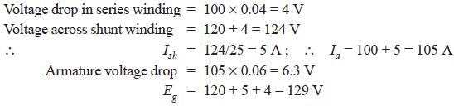
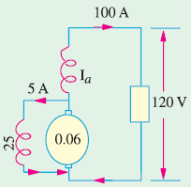
Example - 6

Slide 10
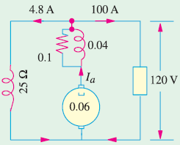
Example - 6
When a diverter of 0.1 Ω is connected in parallel with the series winding, the diagram becomes as shown in Fig. As per current-divider rule, the current through the series winding is = 104.8 × 0.1/(0.1 + 0.04) = 74.86 A. It means that the series field current has decreased from an original value of 104.8 A to 74.86 A. Since No. of turns in the series winding remains the same, the change in series field ampere-turns would be the same as the change in the field current. Hence, the
percentage decrease in the series field ampere-turns = (74.86 − 104.8) × 100/104.8 = −28.6%.

Slide 11
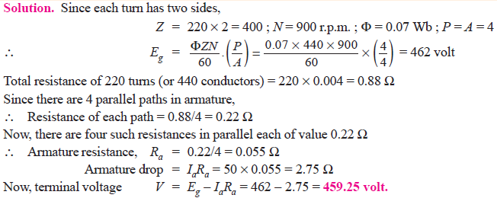
Example - 7
A 4-pole, lap-wound, d.c. shunt generator has a useful flux per pole of 0.07 Wb. The armature winding consists of 220 turns each of 0.004 Ω resistance. Calculate the terminal voltage when running at 900 r.p.m. if the armature current is 50 A.

Slide 12
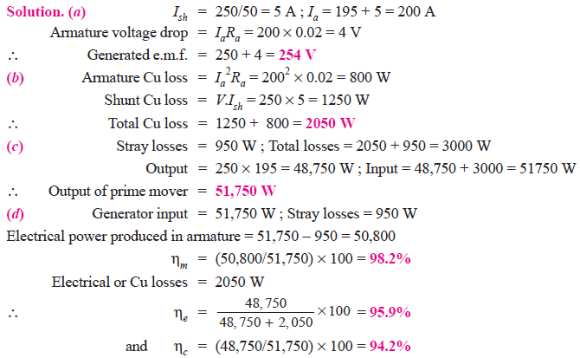
Example - 8
A shunt generator delivers 195 A at terminal p.d. of 250 V. The armature resistance and shunt field resistance are 0.02 Ω and 50 Ω respectively. The iron and friction losses equal 950 W. Find
(a) E.M.F. generated (b) Cu losses (c) output of the prime motor
(d) commercial, mechanical and electrical efficiencies.

Slide 13
Example - 8

Slide 14
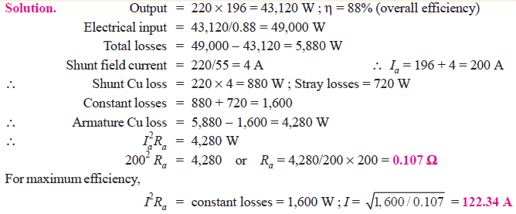
Example - 9
A shunt generator has a F.L. current of 196 A at 220 V. The stray losses are 720 W and the shunt field coil resistance is 55 Ω. If it has a F.L. efficiency of 88%, find the armature resistance. Also, find the load current corresponding to maximum efficiency.

Slide 15
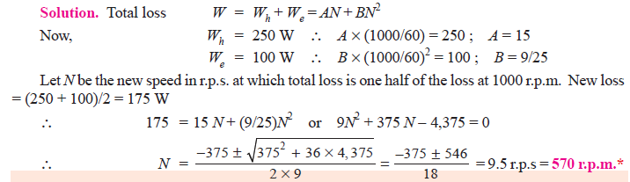
Example - 10
The hysteresis and eddy current losses in a d.c. machine running at 1000 r.p.m. are 250 W and 100 W respectively. If the flux remains constant, at what speed will be total iron losses be halved ?

Slide 16
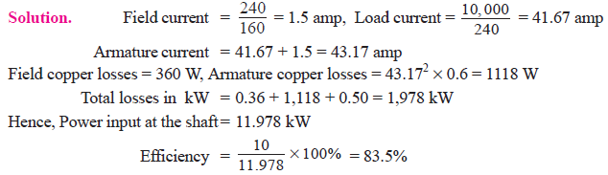
Example - 11
A d.c. shunt generator has a full load output of 10 kW at a terminal voltage of 240 V. The armature and the shunt field winding resistances are 0.6 and 160 ohms respectively. The sum of the mechanical and core-losses is 500 W. Calculate the power required, in kW, at the driving shaft at full load, and the corresponding efficiency.

Slide 17
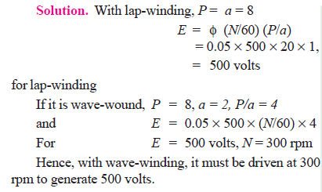
Example - 12
An 8-pole d.c. generator has 500 armature conductors, and a useful flux of 0.05 Wb per pole. What will be the e.m.f. generated if it is lap-connected and runs at 1200 rpm ? What must be the speed at which it is to be driven produce the same e.m.f. if it is wave-wound?

Slide 18
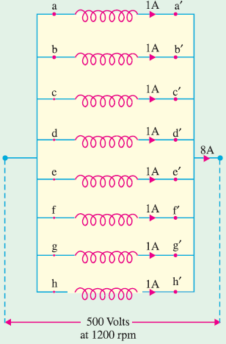
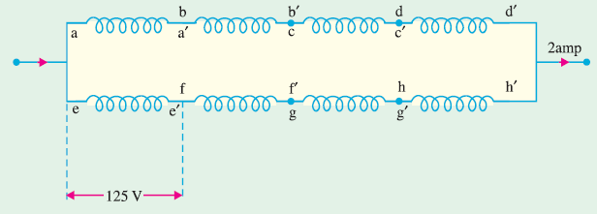
Example - 12

